Slide 1
AWS S3 Datalake
Author: Shrirang Edgaonkar

Slide 2
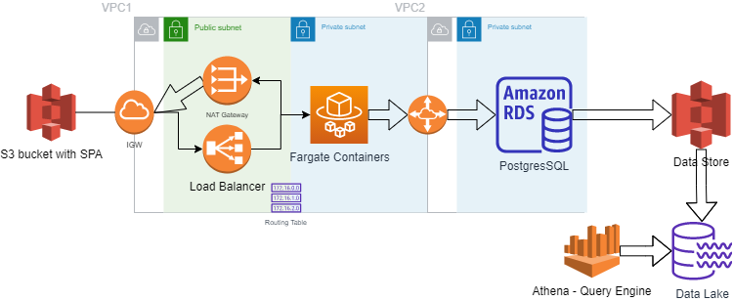
Realtime Ingestion and Query

Slide 3
ReactJS
Spring MVC
Spring Security
Tech Stack
Hibernate
PostgreSQL
Tomcat
Docker
AWS

